Slide 1

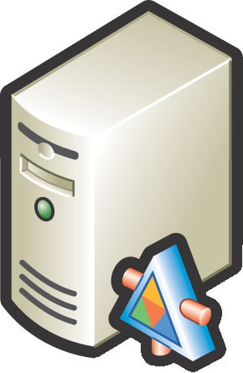


ClearQuest
Synchronization
ClearCase
Team Foundation Server
2008, 2010

Slide 2
ClearQuest
One-Way Migration
ClearCase
Team Foundation Server
2008, 2010

Slide 3
ClearQuest
One-Way Migration
ClearCase
Team Foundation Server
2008, 2010

Slide 4
TFS Integration Tools
TFS Integration Platform
Third-Party
Microsoft
Third-Party
Microsoft

